Slide 1


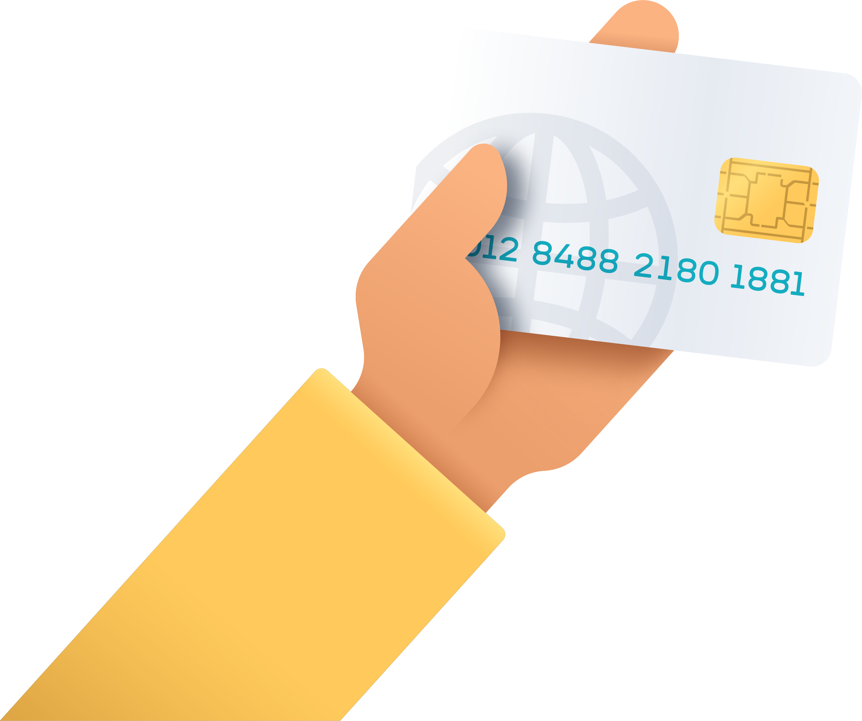





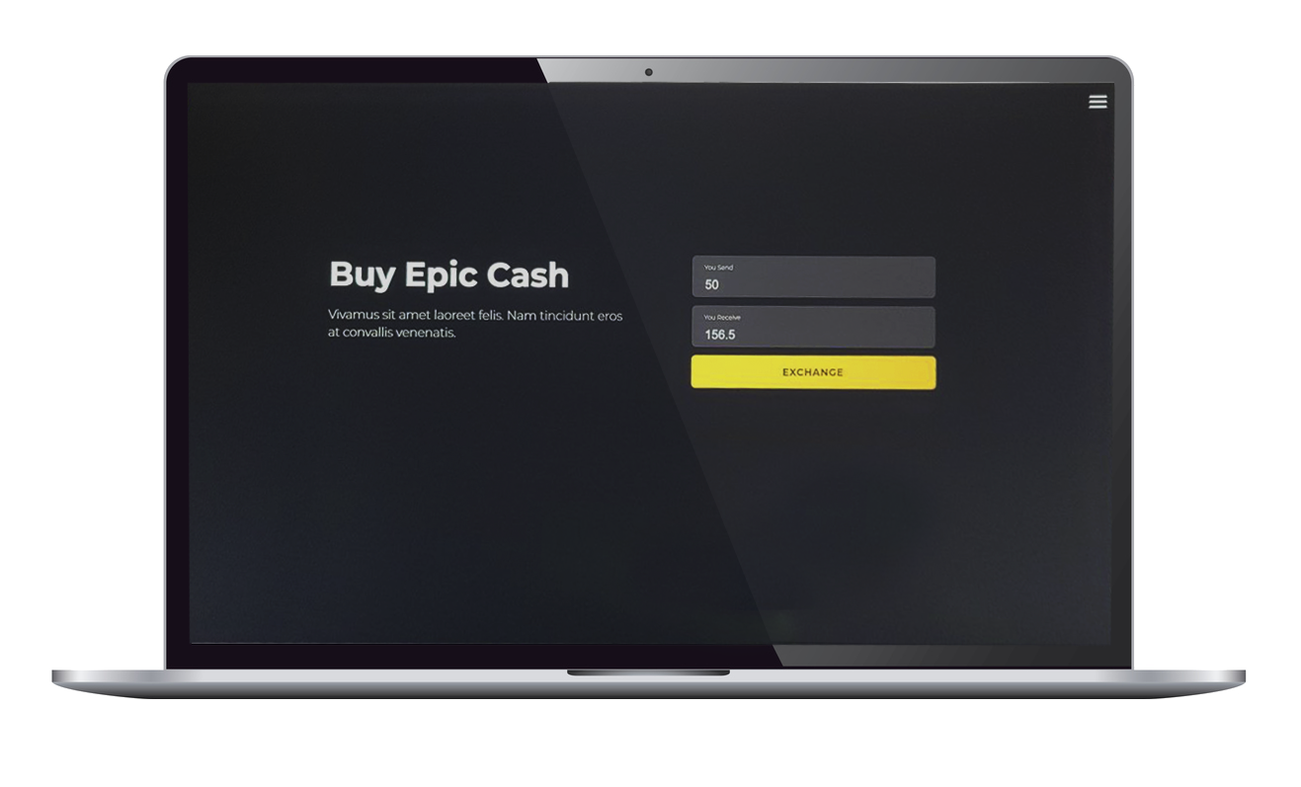








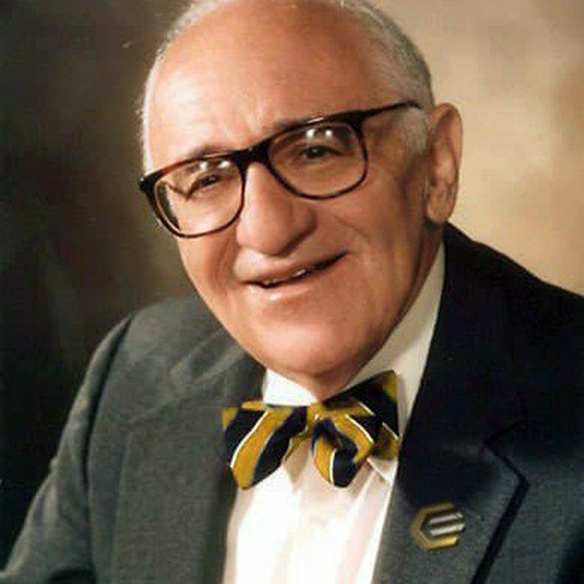

BUY
Using:
With same day delivery, $30 - $12,000 / transaction
Pay with instant ACH on:
THROUGH:
OVER:
VIA:
BuyEpicCash.com
XLM
ON:
SPECIAL THANKS TO:
May 11, 2021
Robert Pieprzny FastEpic Poland
Blacktyg3r Freeman Epicenter DAO UK
Litago Epic-Sh*tswap
Murray R Freeman
https://buyepiccash.com
@MurrayRFreeman
(HOW TO)
EC210502 – Get Epic Cash

